Slide 1

CPU

Slide 2
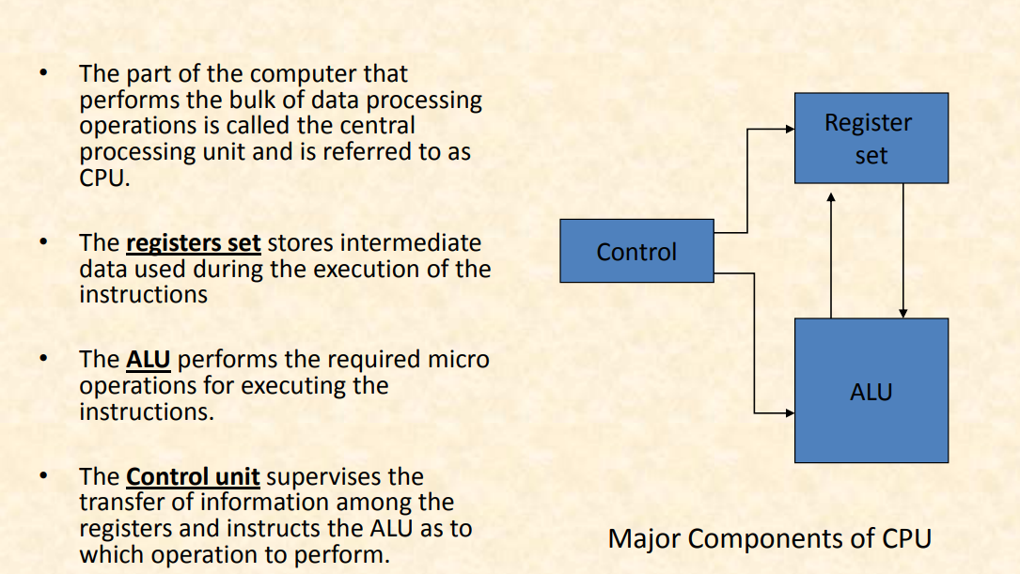

Slide 3
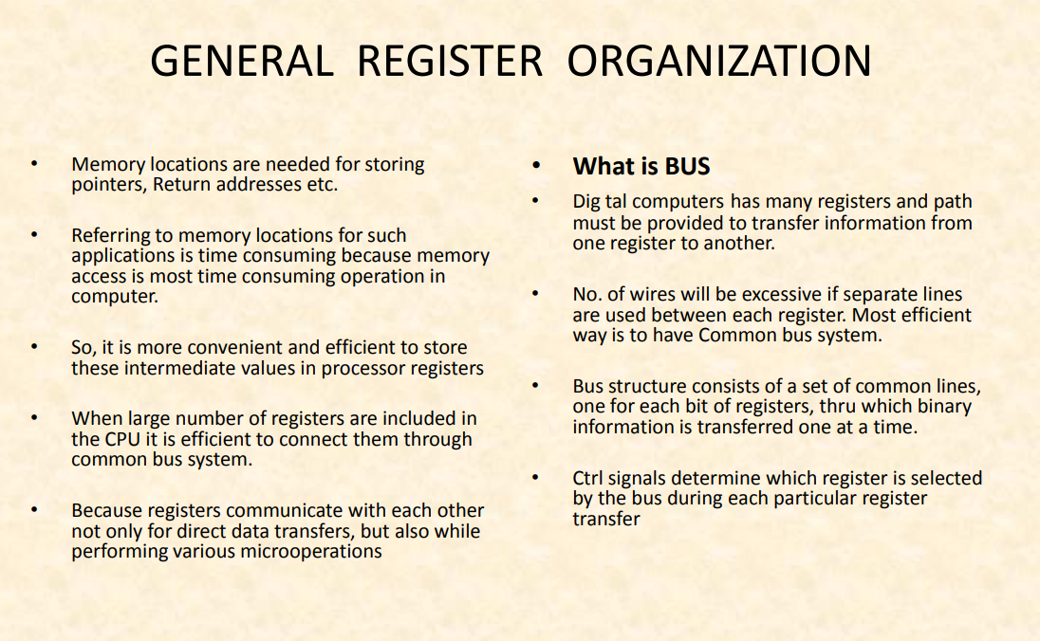

Slide 4
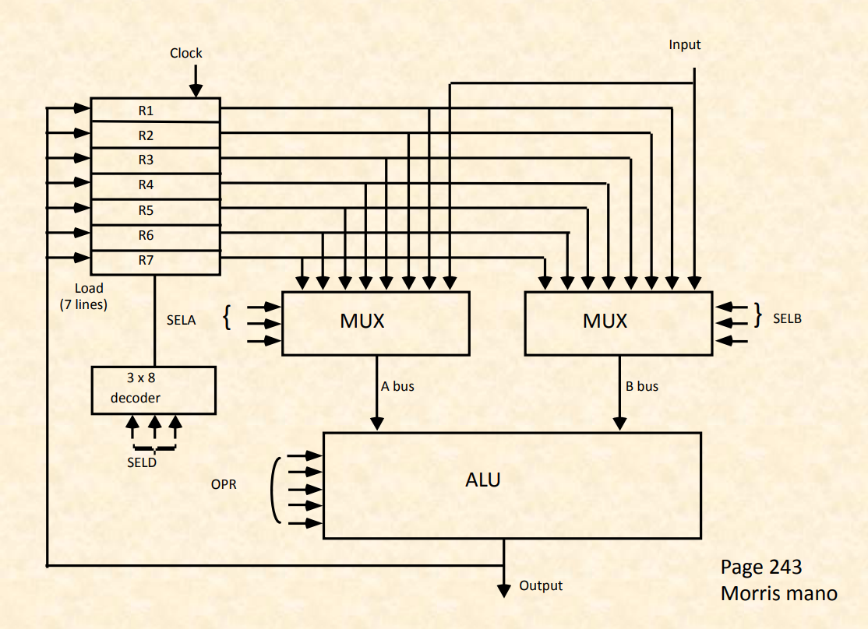

Slide 5
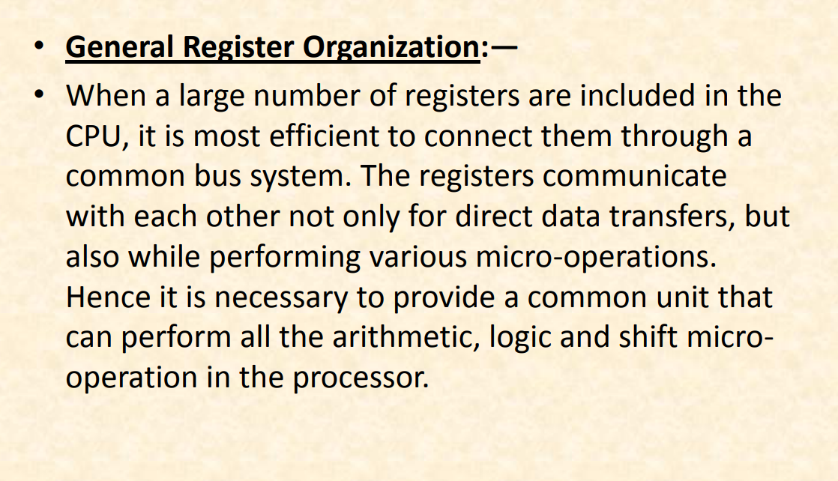

Slide 6
Clock
Input
R1
R2
R3
R4
R5
R6
R7
Load
(7 lines)
{
}
SELA
MUX
MUX
SELB
3 x 8
A bus
B bus
decoder
SELD
OPR
ALU
Output

Slide 7
OPERATION OF CONTROL UNIT
Control
The control unit
Directs the information flow through ALU by
- Selecting various Components in the system
- Selecting the Function of ALU
Example: R1 <- R2 + R3
[1] MUX A selector (SELA): BUS A ← R2
[2] MUX B selector (SELB): BUS B ← R3
[3] ALU operation selector (OPR): ALU to ADD
[4] Decoder destination selector (SELD): R1 ← Out Bus
3
3
3
5
Control Word
SELA
SELB
SELD
OPR
Encoding of register selection fields
Binary
Code SELA SELB SELD
000 Input Input None
001 R1 R1 R1
010 R2 R2 R2
011 R3 R3 R3
100 R4 R4 R4
101 R5 R5 R5
110 R6 R6 R6
111 R7 R7 R7

Slide 8
ALU CONTROL
Control
Encoding of ALU operations
OPR
Select Operation Symbol
00000 Transfer A TSFA
00001 Increment A INCA
00010 ADD A + B ADD
00101 Subtract A - B SUB
00110 Decrement A DECA
01000 AND A and B AND
01010 OR A and B OR
01100 XOR A and B XOR
01110 Complement A COMA
10000 Shift right A SHRA
11000 Shift left A SHLA
Examples of ALU Microoperations
Symbolic Designation
Microoperation SELA SELB SELD OPR Control Word
R1 ← R2 - R3 R2 R3 R1 SUB 010 011 001 00101
R4 ← R4 ∨ R5 R4 R5 R4 OR 100 101 100 01010
R6 ← R6 + 1 R6 - R6 INCA 110 000 110 00001
R7 ← R1 R1 - R7 TSFA 001 000 111 00000
Output ← R2 R2 - None TSFA 010 000 000 00000
Output ← Input Input - None TSFA 000 000 000 00000
R4 ← shl R4 R4 - R4 SHLA 100 000 100 11000
R5 ← 0 R5 R5 R5 XOR 101 101 101 01100

Slide 9
REGISTER STACK ORGANIZATION
Stack Organization
Stack
- Very useful feature for nested subroutines, nested loops control
- Also efficient for arithmetic expression evaluation
- Storage which can be accessed in LIFO
- Pointer: SP
- Only PUSH and POP operations are applicable
stack
Address
Register Stack
Flags
63
FULL
EMPTY
Stack pointer
4
SP
C
3
B
2
A
1
Push, Pop operations
0
DR
/* Initially, SP = 0, EMPTY = 1, FULL = 0 */
PUSH
POP
SP ← SP + 1 DR ← M[SP]
M[SP] ← DR SP ← SP - 1
If (SP = 0) then (FULL ← 1) If (SP = 0) then (EMPTY ← 1)
EMPTY ← 0 FULL ← 0

Slide 10
MEMORY STACK ORGANIZATION
Stack Organization
1000
Memory with Program, Data,
and Stack Segments
PC
Program
(instructions)
AR
Data
(operands)
SP
3000
stack
3997
3998
3999
4000
4001
- A portion of memory is used as a stack with a
processor register as a stack pointer
- PUSH: SP ← SP - 1
M[SP] ← DR
- POP: DR ← M[SP]
SP ← SP + 1
- Most computers do not provide hardware to check
stack overflow (full stack) or underflow(empty stack)
DR

Slide 11
REVERSE POLISH NOTATION
Stack Organization
Arithmetic Expressions: A + B
A + B Infix notation
+ A B Prefix or Polish notation
A B + Postfix or reverse Polish notation
- The reverse Polish notation is very suitable for stack manipulation
Evaluation of Arithmetic Expressions
Any arithmetic expression can be expressed in parenthesis-free
Polish notation, including reverse Polish notation
(3 * 4) + (5 * 6) ⇒ 3 4 * 5 6 * +
6
4
5
5
30
3
3
12
12
12
12
42
3
4
*
5
6
*
+

Slide 12
INSTRUCTION FORMAT
Instruction Format
Instruction Fields
OP-code field - specifies the operation to be performed
Address field - designates memory address(es) or a processor register(s)
Mode field - specifies the way the operand or the
effective address is determined
The number of address fields in the instruction format
depends on the internal organization of CPU
- The three most common CPU organizations:
Single accumulator organization:
ADD X /* AC ← AC + M[X] */
General register organization:
ADD R1, R2, R3 /* R1 ← R2 + R3 */
ADD R1, R2 /* R1 ← R1 + R2 */
MOV R1, R2 /* R1 ← R2 */
ADD R1, X /* R1 ← R1 + M[X] */
Stack organization:
PUSH X /* TOS ← M[X] */
ADD

Slide 13
THREE, AND TWO-ADDRESS INSTRUCTIONS
Instruction Format
Three-Address Instructions
Program to evaluate X = (A + B) * (C + D) :
ADD R1, A, B /* R1 ← M[A] + M[B] */
ADD R2, C, D /* R2 ← M[C] + M[D] */
MUL X, R1, R2 /* M[X] ← R1 * R2 */
- Results in short programs
- Instruction becomes long (many bits)
Two-Address Instructions
Program to evaluate X = (A + B) * (C + D) :
MOV R1, A /* R1 ← M[A] */
ADD R1, B /* R1 ← R1 + M[A] */
MOV R2, C /* R2 ← M[C] */
ADD R2, D /* R2 ← R2 + M[D] */
MUL R1, R2 /* R1 ← R1 * R2 */
MOV X, R1 /* M[X] ← R1 */

Slide 14
ONE, AND ZERO-ADDRESS INSTRUCTIONS
Instruction Format
One-Address Instructions
- Use an implied AC register for all data manipulation
- Program to evaluate X = (A + B) * (C + D) :
LOAD A /* AC ← M[A] */
ADD B /* AC ← AC + M[B] */
STORE T /* M[T] ← AC */
LOAD C /* AC ← M[C] */
ADD D /* AC ← AC + M[D] */
MUL T /* AC ← AC * M[T] */
STORE X /* M[X] ← AC */
Zero-Address Instructions
- Can be found in a stack-organized computer
Program to evaluate X = (A + B) * (C + D)
➔ (REVERSE POLISH NOTATION) A B + C D + *:
PUSH A /* TOS ← A */
PUSH B /* TOS ← B */
ADD /* TOS ← (A + B) */
PUSH C /* TOS ← C */
PUSH D /* TOS ← D */
ADD /* TOS ← (C + D) */
MUL /* TOS ← (C + D) * (A + B) */
POP X /* M[X] ← TOS */

